Slide 1
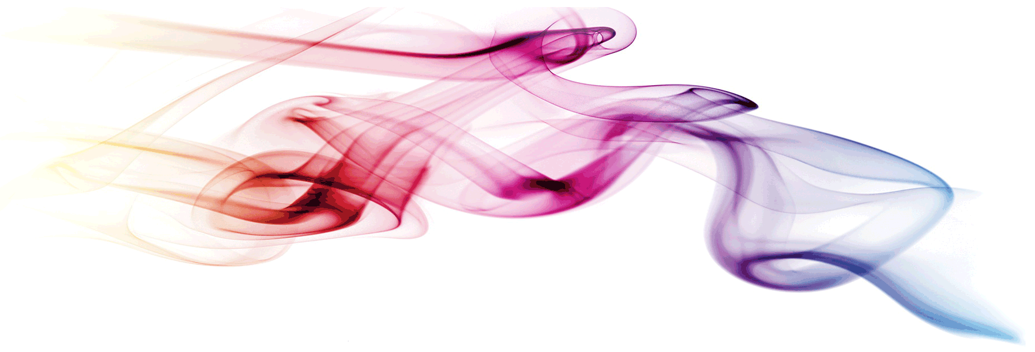
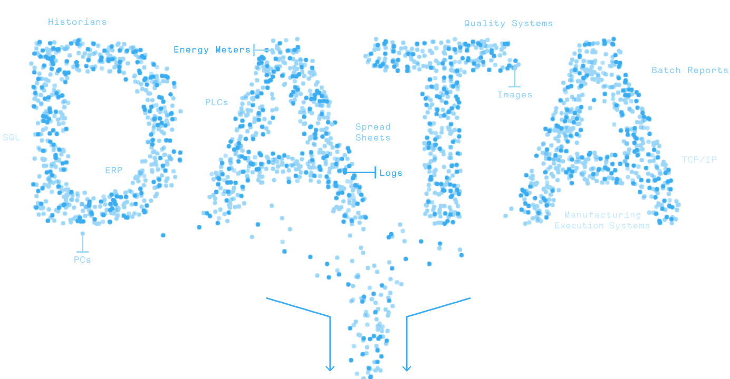
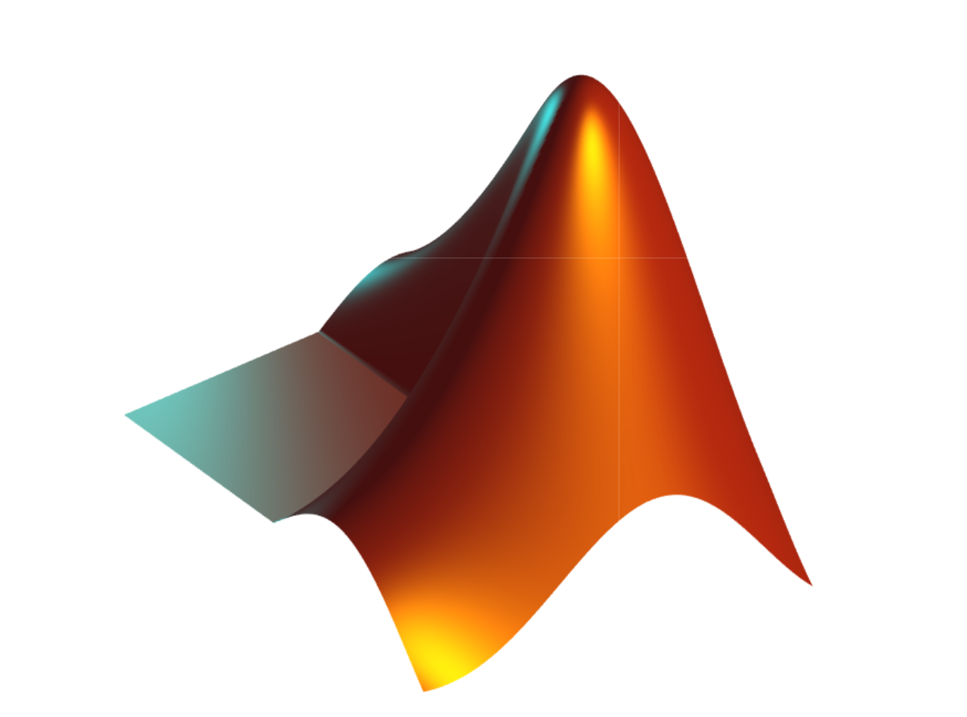
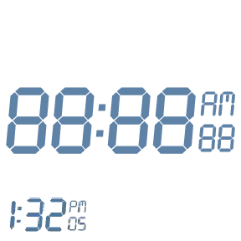
MATLAB Fundamental Laboratory Handbook (MATLAB)
Chapter 12 Image Processing
Dr Leo Chen
leo.chen@ieee.org
1

Slide 2
Image Processing Fundamentals
The function imread reads an image from a file into the MATLAB workspace.
MATLAB images can be of type intensity (grayscale), binary, or RGB (Color)
Intensity images use values [0,1] (double) or [0,255] (uint8) to represent brightness, whereas binary images have values 0 or 1, and RGB images are stored as three matrices (one per color channel)
I = imread('rooster.jpg'); % Read color image
Ib = imread('elephant.png'); % Read another image
I_gray = rgb2gray(I); % Convert RGB to grayscale
I_double = im2double(I_gray); % Convert to double precision [0,1]
imshow(imagesc(I(:,:,1)));

Slide 3
Image Conversion and Display
To change an image’s format or colormap, MATLAB provides functions like colormap and image conversion routines (e.g. rgb2gray, im2bw, ind2rgb, mat2gray).
By default, imshow displays grayscale correctly, but imagesc uses the current colormap.
figure;
imshow(I_double); % Display image (grayscale by default)
figure;
imagesc(I_double); colormap gray; % Display with imagesc and gray colormap
colorbar; axis off; axis equal; % Hide axis labels, enforce equal aspect

Slide 4
Image Reshaping, Cropping and Creation
In MATLAB, an image is stored as a matrix. You can reshape, crop, or modify parts of an image using standard matrix indexing. Creating synthetic images allows controlled experiments.
cropped = I(100:320, 80:380); % Crop a region from an image
cropped(150:200,1:50) = 255; % Make part of the image white
% Create a synthetic image with three intensity levels
Iart = zeros(201, 201); % All black
Iart(51:150, 51:150) = 1; % White square
Iart(81:120,:) = 0.5; % Gray horizontal band
Iart(:,81:120) = 0.75; % Brighter vertical band
% Convert to vector and back to matrix
Iartv = Iart(:);
Inew = reshape(Iartv, 201, 201);

Slide 5
Image Resizing
I = imread('elephant.png'); % Read the image
I_gray = rgb2gray(I); % Convert to grayscale (if needed)
Ibsmall = imresize(I_gray, 0.5); % Scale down by factor of 0.5
Iblarge = imresize(I_gray, 2); % Scale up by factor of 2
figure;
subplot(1,3,1), imshow(I_gray), title('Original');
subplot(1,3,2), imshow(Ibsmall), title('Scaled Down');
subplot(1,3,3), imshow(Iblarge), title('Scaled Up');

Slide 6
Image Output
% Save image as PNG file
imwrite(Inew, 'rooster_new.png', 'png');
% Save image in MATLAB format
save('my_processed_image.mat', Inew');

Slide 7
Convolution Operations
Convolution is a fundamental linear filtering operation. A small matrix (kernel) is slid over the image, multiplying and summing local pixels to produce the output.
Convolution can implement blurring, sharpening, edge detection, etc.
img = im2double(imread('elephant.png'));
h = ones(5,5)/25; % 5x5 averaging kernel
I_box = conv2(img, h, 'same'); % Apply convolution, keep same size
figure; imagesc(I_box); colormap gray;
In MATLAB, conv2(A,h,'same') applies filter h centered at each pixel. Complex filters (e.g. Gaussian or edge detectors) are implemented similarly.
help conv2

Slide 8
Smoothing and Difference Masks
help fspecial
Box masks
Gaussian mask
h_box = fspecial('average', [7 7]); % 7×7 box filter
I_smooth_box = conv2(I_double, h_box, 'same');
h_gauss = fspecial('gaussian', [7 7], 2); % 7×7 Gaussian, σ=2
I_smooth_gauss = conv2(I_double, h_gauss, 'same');

Slide 9
Smoothing and Difference Masks
h_sobel = fspecial('sobel'); % 3×3 Sobel horizontal filter
h_prewitt = fspecial('prewitt'); % 3×3 Prewitt horizontal filter
sobel_x = fspecial('sobel');
sobel_y = sobel_x';
Gx = conv2(I_double, sobel_x, 'same');
Gy = conv2(I_double, sobel_y, 'same');
G = sqrt(Gx.^2 + Gy.^2);
figure, imagesc(G); colormap gray; colorbar;
subplot(1,2,1), imagesc(Gx); title('Vertical edges (Gx)'); colormap gray;
subplot(1,2,2), imagesc(Gy); title('Horizontal edges (Gy)'); colormap gray

Slide 10
Gaussian Derivatives
g = fspecial('gaussian', [31 31], 5); % 2D Gaussian σ=5
hx = conv2(g, [1 -1], 'same'); % Gaussian derivative (x-direction)
hy = conv2(g, [1; -1], 'same'); % Gaussian derivative (y-direction)
Ix = conv2(I_double, hx, 'same'); % Image derivative in x
Iy = conv2(I_double, hy, 'same'); % Image derivative in y
tic
toc

Slide 11
Convolution Operations
Convolution is a fundamental linear filtering operation. A small matrix (kernel) is slid over the image, multiplying and summing local pixels to produce the output.
Convolution can implement blurring, sharpening, edge detection, etc.
img = im2double(imread('elephant.png'));
h = ones(5,5)/25; % 5x5 averaging kernel
h = [1 0 -1; 1 0 -1; 1 0 -1]; % This kernel detects vertical edges
I_box = conv2(img, h, 'same'); % Apply convolution, keep same size
figure; imagesc(I_box); colormap gray;
In MATLAB, conv2(A,h,'same') applies filter h centered at each pixel. Complex filters (e.g. Gaussian or edge detectors) are implemented similarly.
help conv2

Slide 12
Smoothing and Difference Masks
help fspecial
Box masks
Gaussian mask
h_box = fspecial('average', [7 7]); % 7×7 box filter
I_smooth_box = conv2(I_double, h_box, 'same');
h_gauss = fspecial('gaussian', [7 7], 2); % 7×7 Gaussian, σ=2
I_smooth_gauss = conv2(I_double, h_gauss, 'same');

Slide 13
Smoothing and Difference Masks
% Create 5x5 and 25x25 box filters (normalized to sum to 1)
h_small = ones(5,5) / 25;
h_large = ones(25,25) / 625;
% Alternatively:
h_small = fspecial('average', [5 5]); % 5x5 average filter
h_large = fspecial('average', [25 25]); % 25x25 average filter
I = im2double(rgb2gray(Ib)); % example image (elephant) as double grayscale
I_blur1 = conv2(I, h_small, 'same'); % apply 5x5 blur
I_blur2 = conv2(I, h_large, 'same'); % apply 25x25 blur

Slide 14
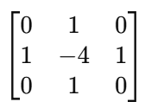
Smoothing and Difference Masks
1D Difference Masks:
dx = [1 -1]; % horizontal difference filter
Iy = conv2(I, dx', 'same'); % vertical difference (by using column vector)
Ix = conv2(I, dx, 'same'); % horizontal difference
Laplacian Filter (2D second-order difference):
h_lap = fspecial('laplacian', 0); % standard 3x3 Laplacian kernel
I_lap = conv2(I, h_lap, 'same');

Slide 15
Difference-of-Gaussians (DoG)
g1 = fspecial('gaussian',[31 31], 2); % Gaussian sigma=2
g2 = fspecial('gaussian',[31 31], 5); % Gaussian sigma=5 (wider blur)
h_dog = g1 - g2; % difference of Gaussians kernel
I_dog = conv2(I, h_dog, 'same');
tic
toc

Slide 16
Smoothing and Difference Masks
Difference masks and filters help detect changes in intensity:
1st-order differences (like [1 -1]) detect edges in one orientation.
2nd-order differences (Laplacian) detect edges but typically require careful interpretation (zero-crossings).
Difference-of-Gaussians detects edges and blobs at a given scale, mimicking vision systems

Slide 17
Edge Detection Techniques
Sobel Operator
Prewitt Operator
Gaussian Derivative (gradient)
Laplacian of Gaussian (LoG)
Canny

Slide 18
Sobel and Prewitt operators
hs = fspecial('sobel'); % Sobel kernels
Gx = conv2(I, hs, 'same'); % horizontal gradient
Gy = conv2(I, hs', 'same'); % vertical gradient
M_sobel = sqrt(Gx.^2 + Gy.^2);
hp = fspecial('prewitt'); % Prewitt kernels
Px = conv2(I, hp, 'same');
Py = conv2(I, hp', 'same');
M_prewitt = sqrt(Px.^2 + Py.^2);

Slide 19
Laplacian of Gaussian (LoG)
h_log = fspecial('log', [15 15], 2.0); % LoG filter, 15x15 kernel, σ=2
I_log = conv2(I, h_log, 'same');

Slide 20
Canny edge detector
Gaussian smoothing to reduce noise (σ typically 1–2).
Gradient computation (usually via Sobel) to get magnitude and direction.
Non-maximum suppression: thin edges by keeping only local maxima along the gradient direction.
Double threshold + hysteresis:
Pixels above the high threshold → strong edges
Pixels between low and high → weak edges (kept only if connected to a strong edge)
Below low → discarded

Slide 21
Canny (Multi-Stage Optimal Edge Detector)
sigma = 1.5;
lowThresh = 0.1; % adjust to taste
highThresh = 0.3;
BW = edge(I, 'Canny', [lowThresh highThresh], sigma);
% Display:
figure;
subplot(2,2,1), imshow(I), title('Original');
subplot(2,2,2), imagesc(M_sobel), colormap gray; colorbar; title('Sobel');
subplot(2,2,3), imagesc(I_log), colormap gray; colorbar; title('LoG');
subplot(2,2,4), imshow(BW), title('Canny');

Slide 22
Edge Detection Techniques
Sobel/Prewitt: simple gradient magnitude, thicker edges, more noise.
LoG: highlights zero-crossings, often produces double-lined edges that require post-processing.
Canny: yields thin, clean, connected edges, robust to noise (thanks to initial smoothing) and uses adaptive thresholding via hysteresis.

